Slide 1
Resolving Blurry Output
Presenter: Kim Seung Hwan (overnap@khu.ac.kr)

Slide 2
My Claim
The performance of LDM depends on the distribution created by the outer regularized AE
This means that (V)AE alone can achieve excellent performance if we sample well

Slide 3
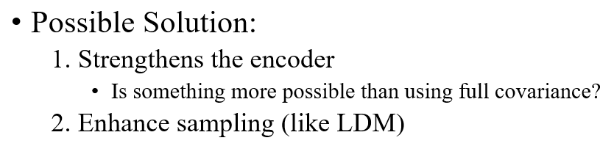
TODO
Plan to achieve good performance with VAE alone by incorporating existing sampling techniques into Full Covariance VAE
Check whether the performance is good with only the VAE in LDM (I wonder why this was not provided in the paper)

Slide 4
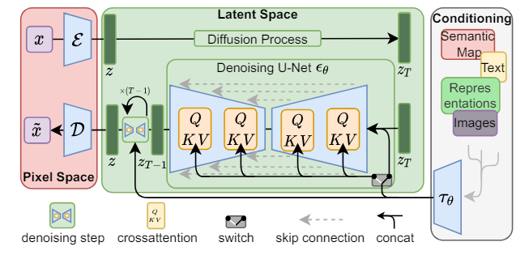
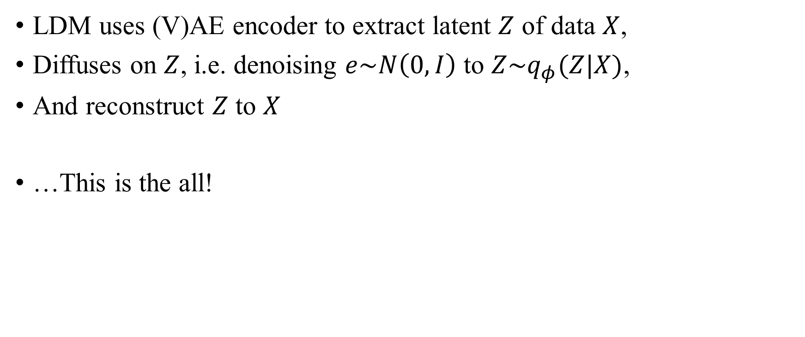
Why does LDM works well?
LDM uses (V)AE encoder to extract latent $Z$ of data $X$,
Diffuses on $Z$, i.e. denoising $e\sim N\left(0, I\right)$ to $Z\sim q_{φ}(Z|X)$,
And reconstruct $Z$ to $X$
…This is the all!

Slide 5
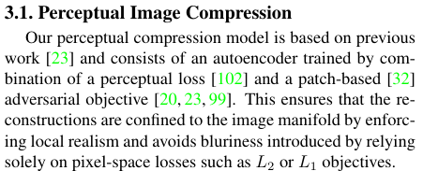
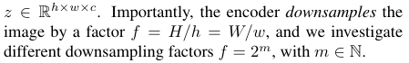
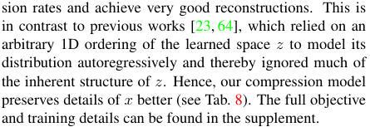
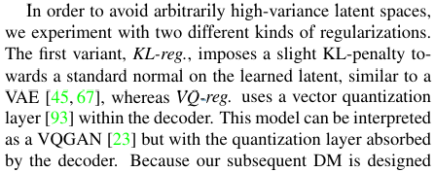
Details
Maintaining 2D structure
Might be important
Perceptual loss & Patch-based adversarial objective
Very technical; probably not important
But 1D latent space is just a rearrangement
Does it really matter?
The author claims it matters
KL from VAE, VQ from VQGAN
Both are very powerful loss,
But have been well studied already

Slide 6
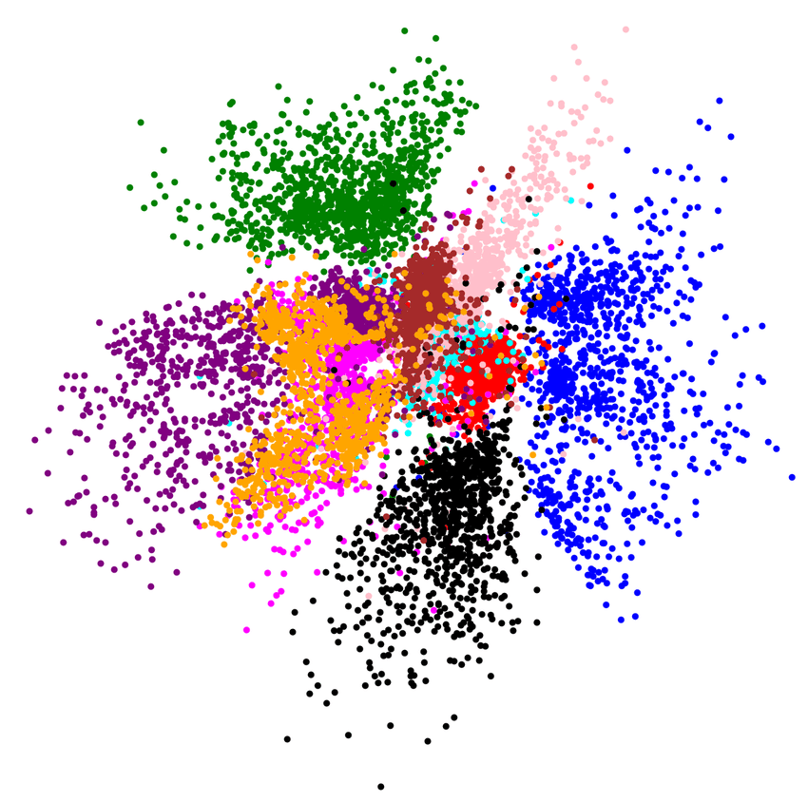
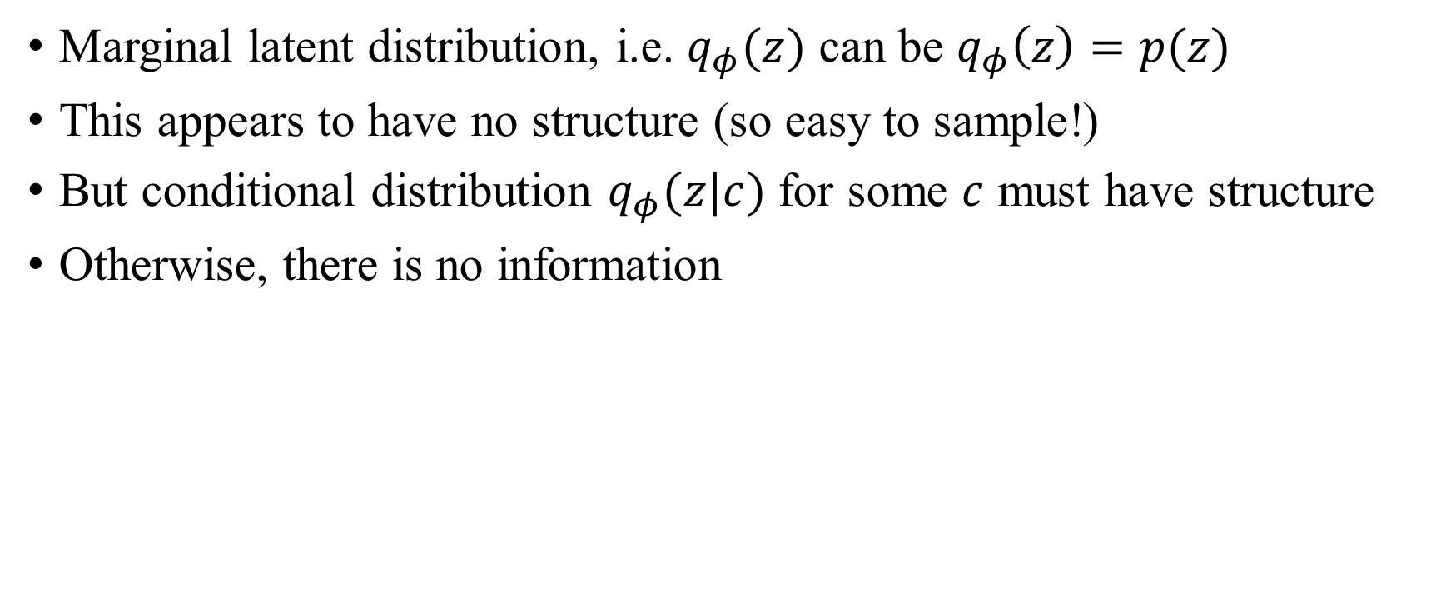
Structured Latent Variable
Marginal latent distribution, i.e. $q_{φ}(z)$ can be $q_{φ}\left(z\right)=p(z)$
This appears to have no structure (so easy to sample!)
But conditional distribution $q_{φ}(z|c)$ for some $c$ must have structure
Otherwise, there is no information

Slide 7
Structured Latent Variable
The 2D-structured distribution of LDM means nothing by itself
However, several conditions must be taken into consideration
AE part of LDM contains convolution layer
It can have arbitrarily prior distribution; because of sampling by DM part

Slide 8
Structured Latent Variable
Because of convolution, 2D structures can make sense
But it is not different from existing implementation

Slide 9
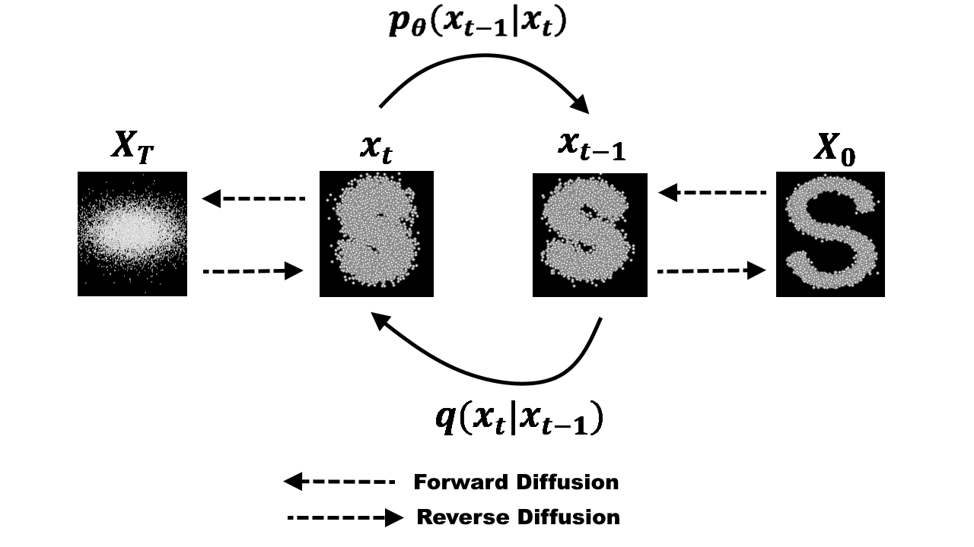
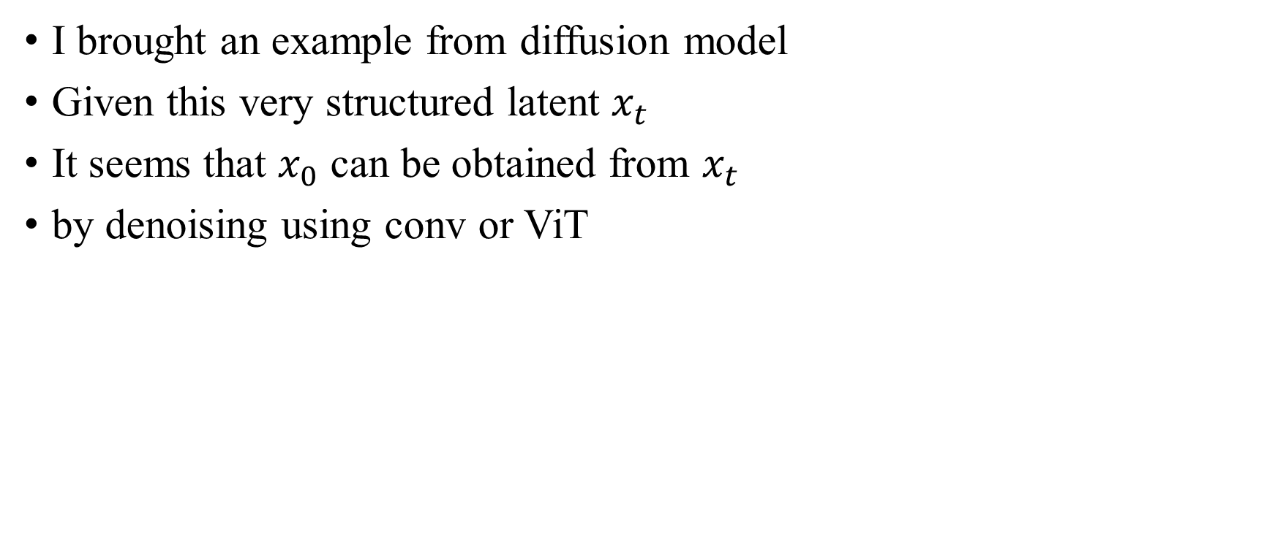
Structured Latent Variable
I brought an example from diffusion model
Given this very structured latent $x_{t}$
It seems that $x_{0}$ can be obtained from $x_{t}$
by denoising using conv or ViT

Slide 10
Structured Latent Variable
Note that ordering in 2D itself is not important
Even if we cut it into 1D, we can order it (by MLP or something)

Slide 11
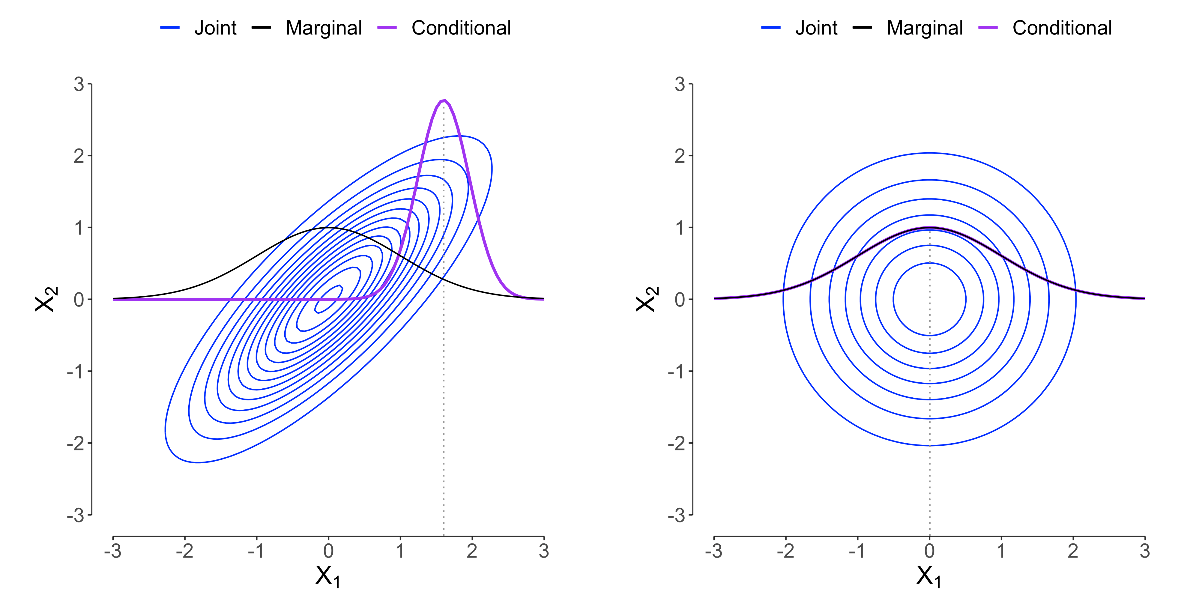
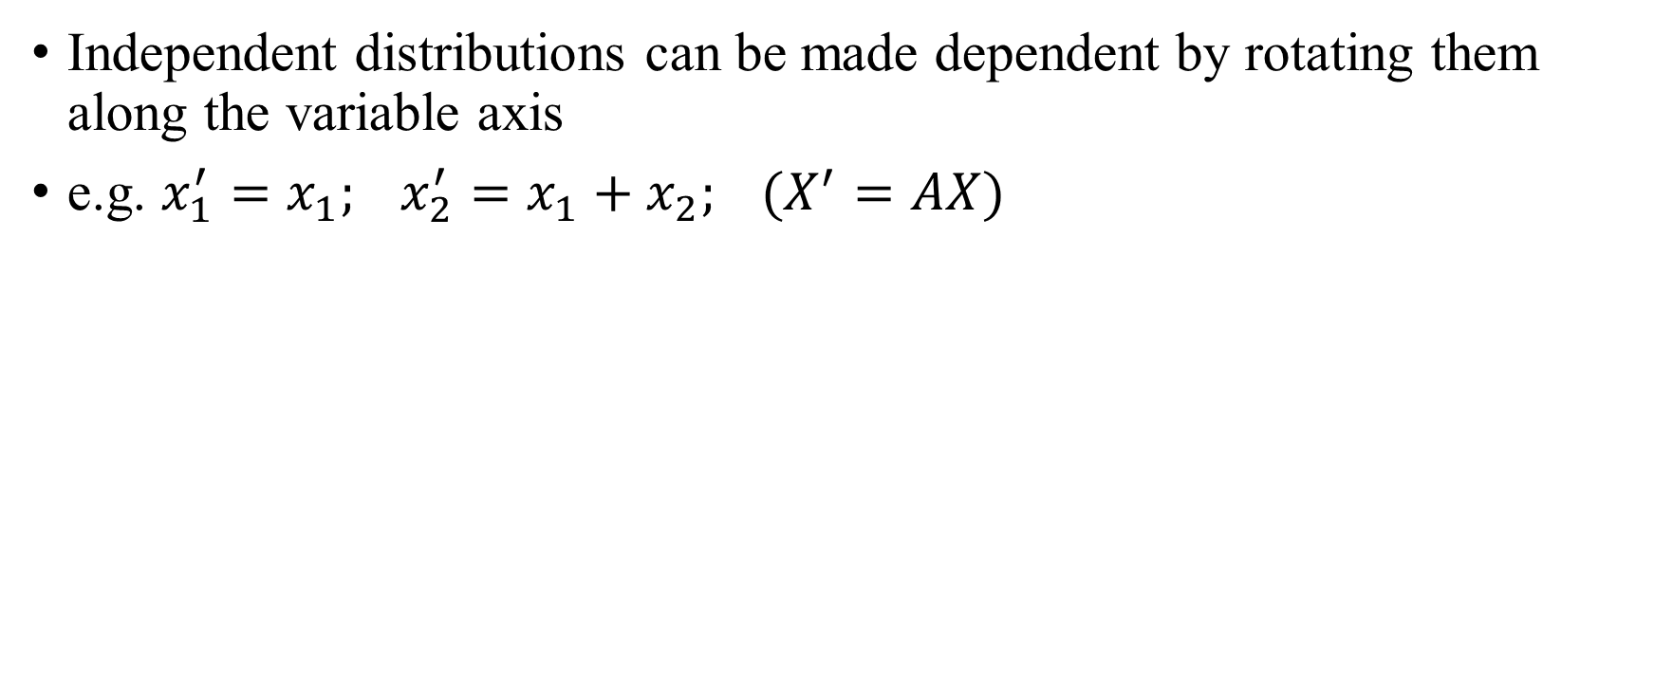
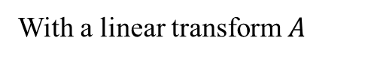
Linear Transform of Latent
Independent distributions can be made dependent by rotating them along the variable axis
e.g. $x_{1}^{′}=x_{1}; x_{2}^{′}=x_{1}+x_{2}; (X^{′}=AX)$
With a linear transform $A$

Slide 12
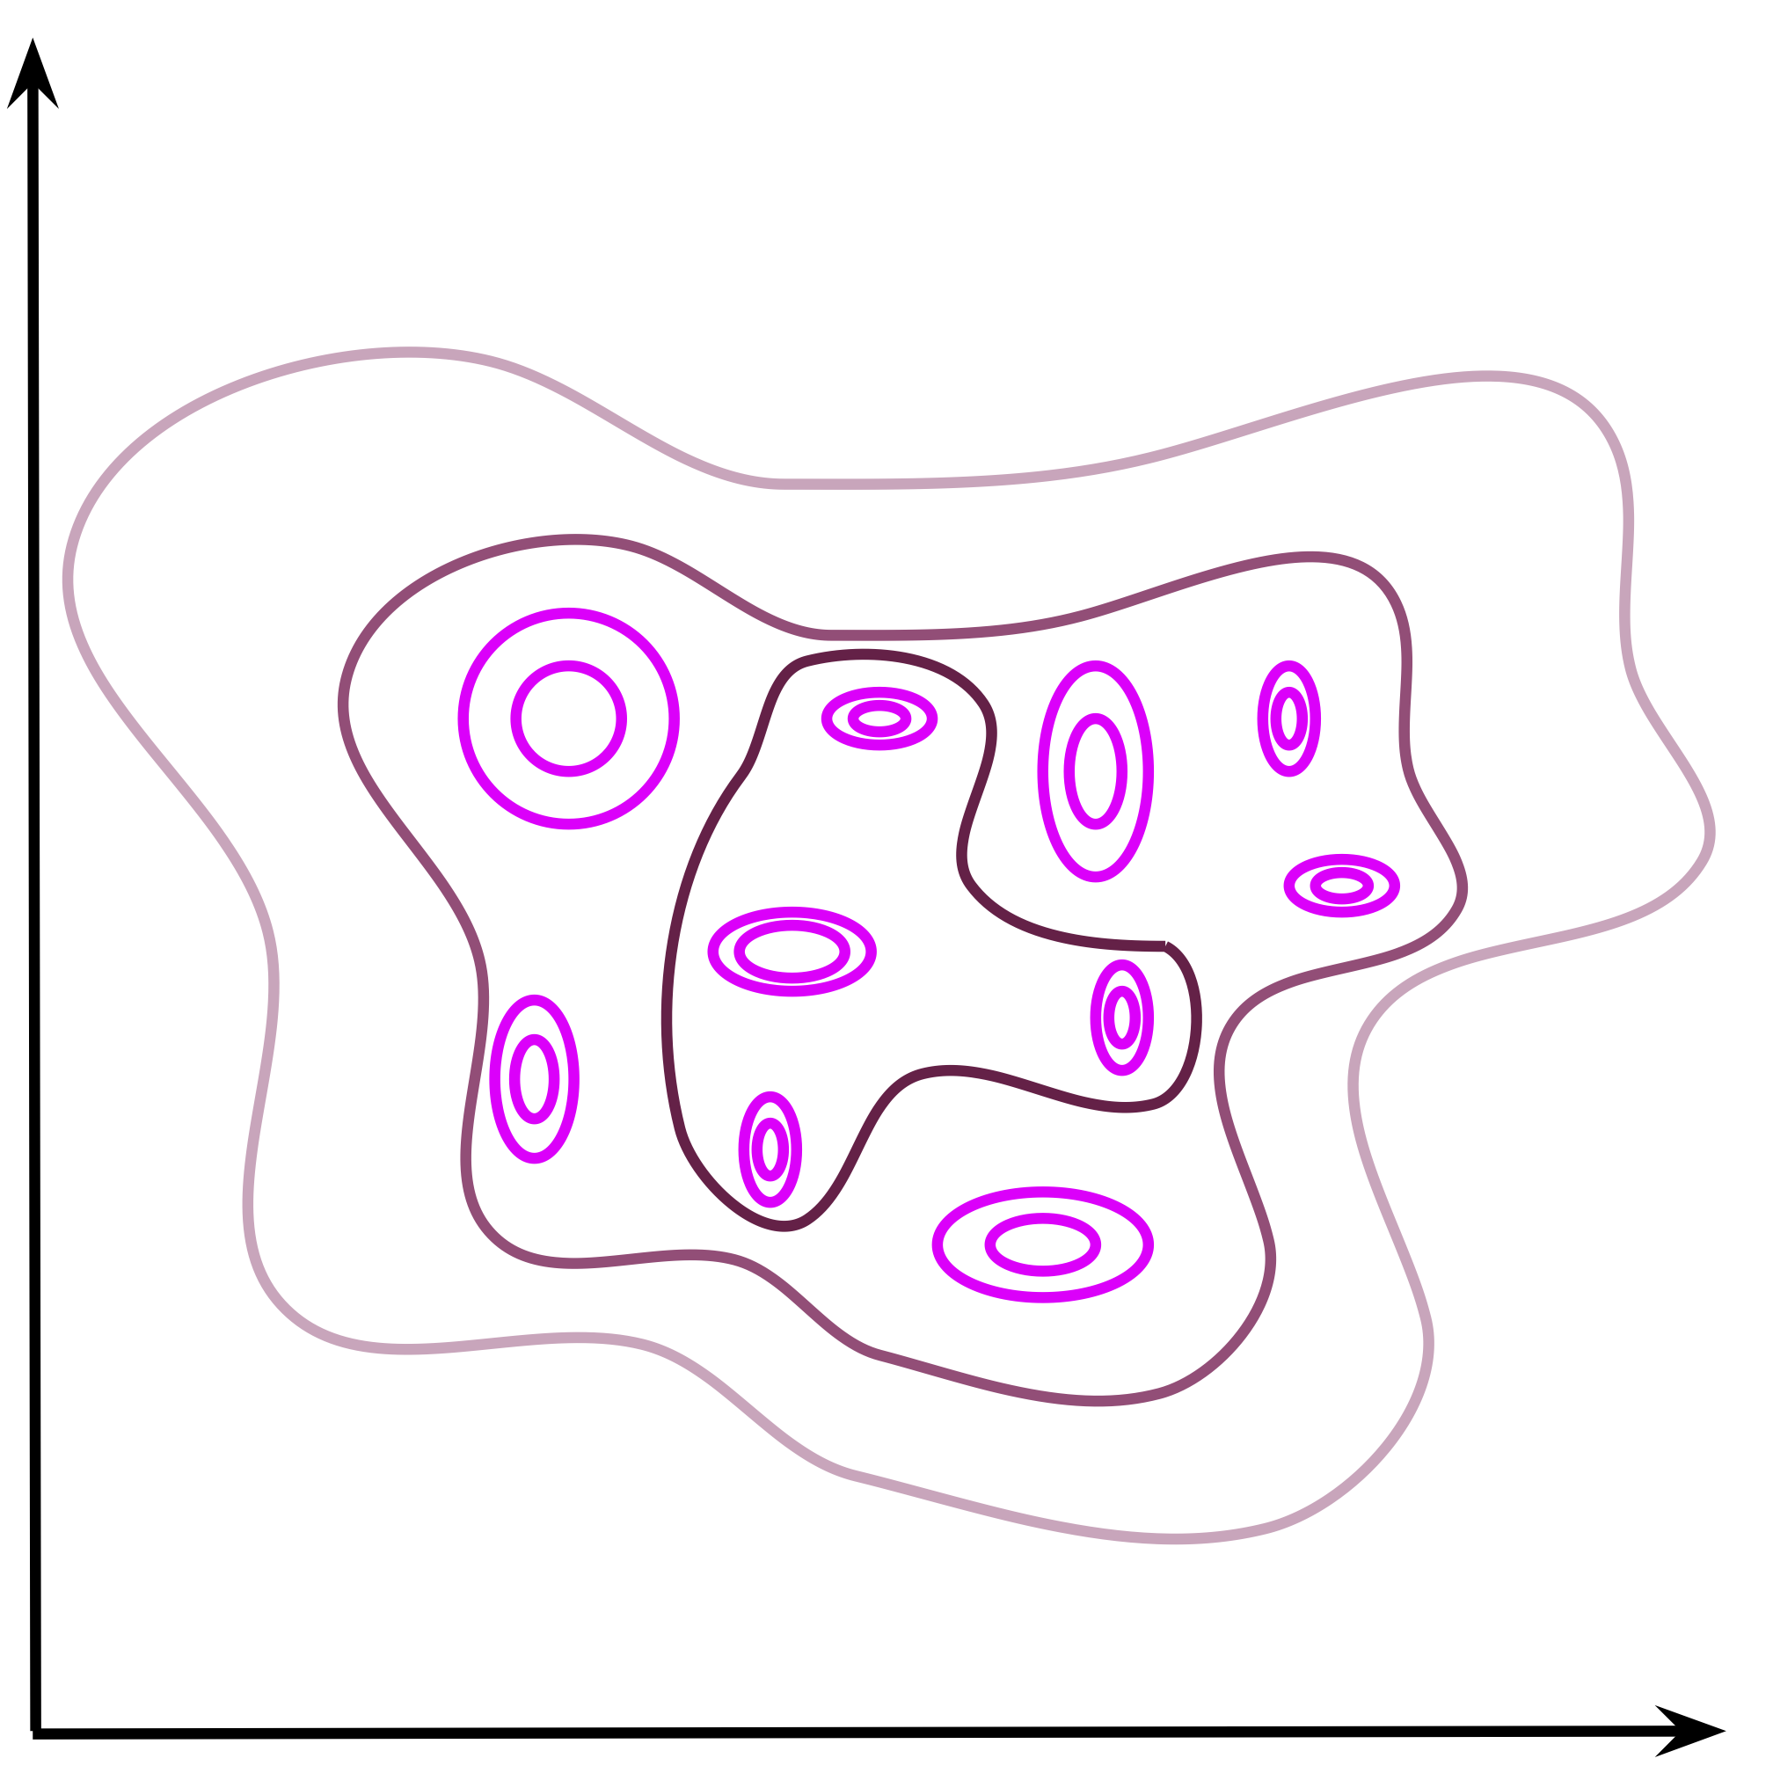
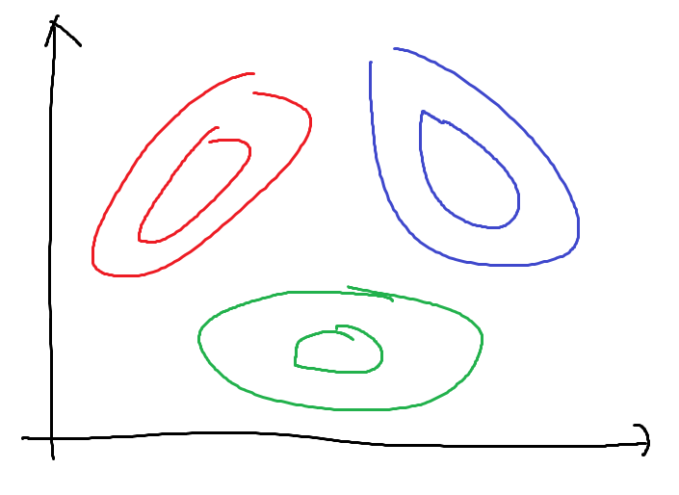
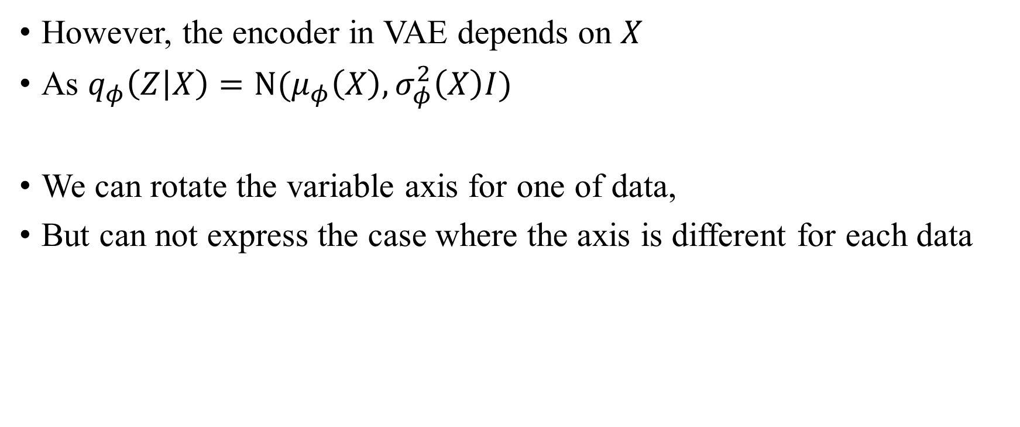
Linear Transform of Latent
However, the encoder in VAE depends on $X$
As $q_{φ}\left(Z | X\right)=N(μ_{φ}\left(X\right), σ_{φ}^{2}\left(X\right)I)$
We can rotate the variable axis for one of data,
But can not express the case where the axis is different for each data

Slide 13
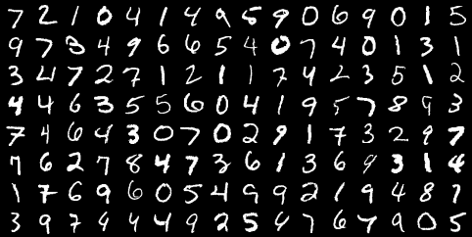


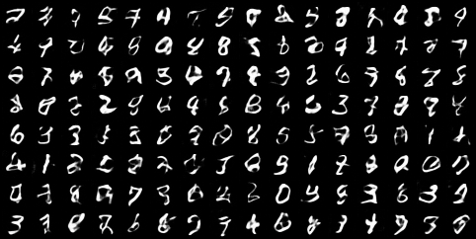
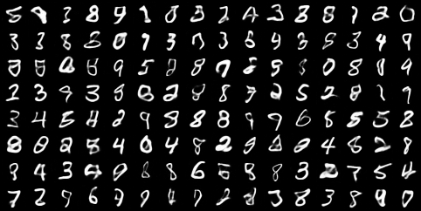
Experimental Result
MNIST
FID: 29
FID: 17

Slide 14
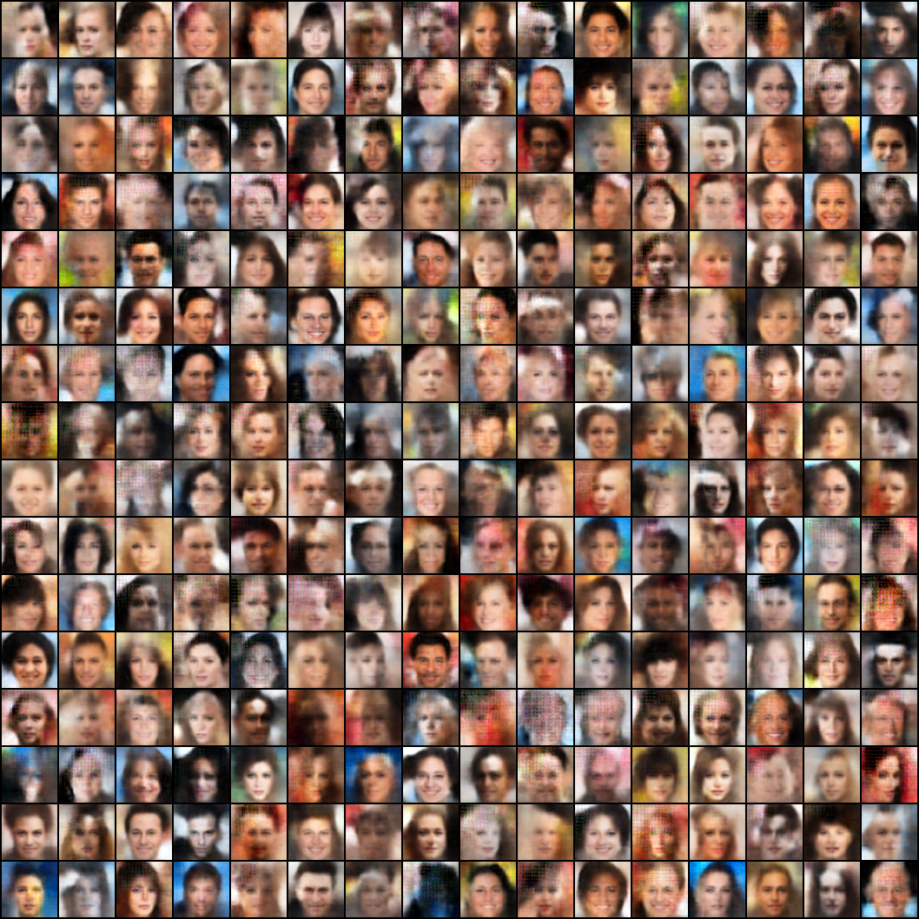
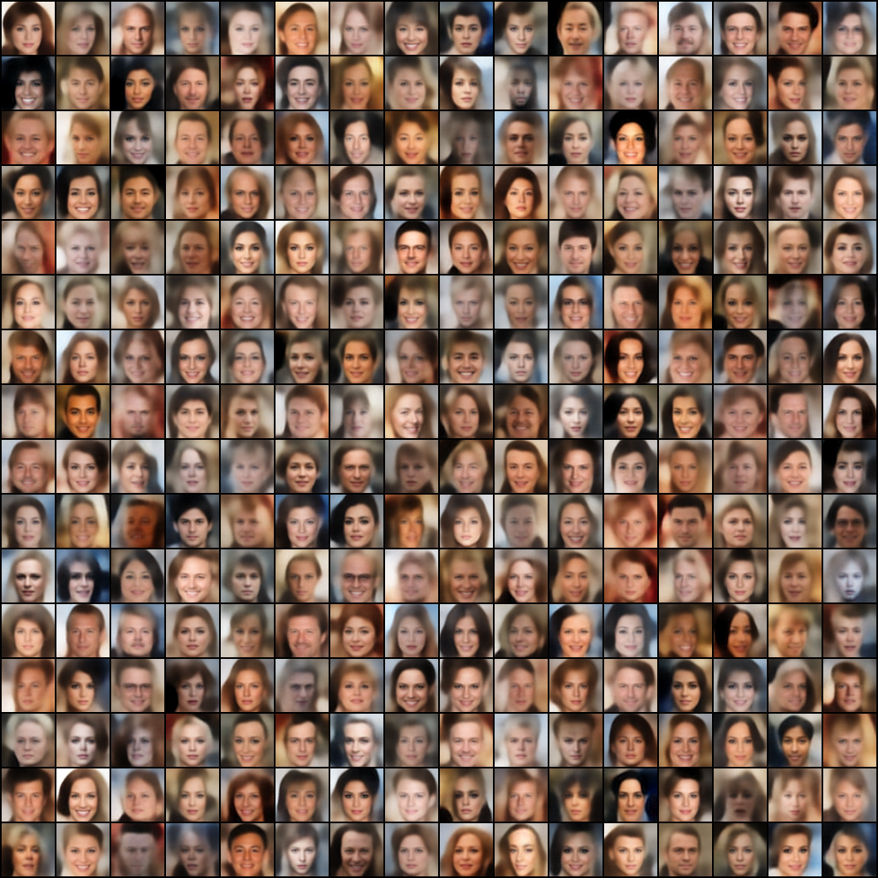
Experimental Result
CelebA
FID: 118
FID: 72

Slide 15
TODO
I’ve struggled with this 😭
Plan to achieve good performance with VAE alone by incorporating existing sampling techniques into Full Covariance VAE
Check whether the performance is good with only the VAE in LDM (I wonder why this was not provided in the paper)

Slide 16
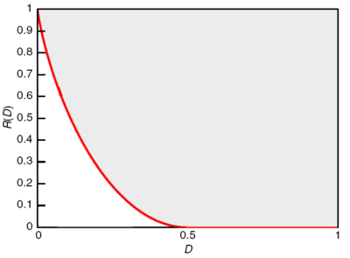
Blurry Output
VAE is notorious for its blurry output
This blurry output is explained by rate-distortion tradeoff ideally

Slide 17
Blurry Output
In practice, there is a very complex relationship involved…

Slide 18
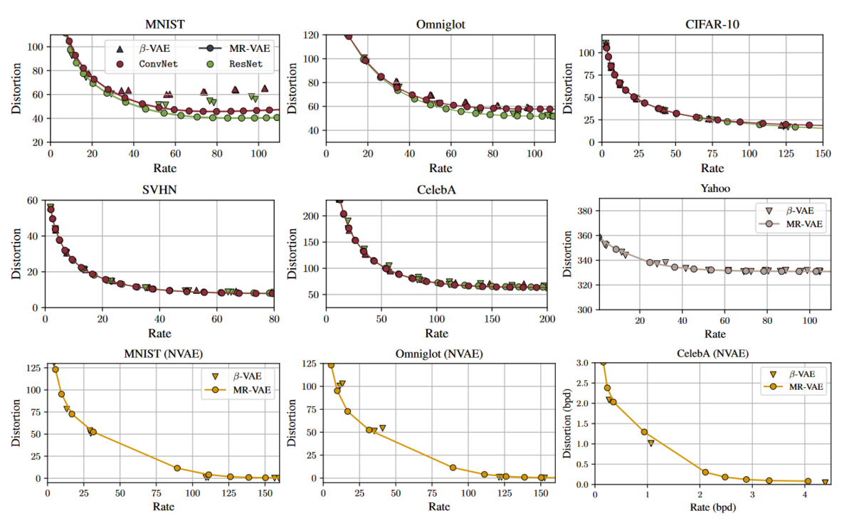
Blurry Output
1.
Basically, there is a RD tradeoff
It changes depending on the beta value

Slide 19
Blurry Output
2.
However, in conventional implementation, if we adjust the beta value, the decoder variance also changes!
We can not get a pure RD tradeoff
This is the claim from my ICIP paper

Slide 20
Blurry Output
3.
If the beta is set too low, sampling will not be possible
This is because aggregated posterior is not like prior
It is necessary to “lower beta appropriately”

Slide 21
Blurry Output
4.
Due to the nature of the autoencoder,
the dimension is greatly reduced and then restored
It is easy to miss the local features,
Which contributes to clarity of output

Slide 22
Blurry Output
I want to leave out anything about sampling or decoders
I just want to get a tradeoff between clarity and variety of output

Slide 23
Blurry Output
Rough ideas 1
The sampling justification proof of the two-step VAE seems to be applicable to beta-VAE as well
What if we only set beta in the front VAE?

Slide 24
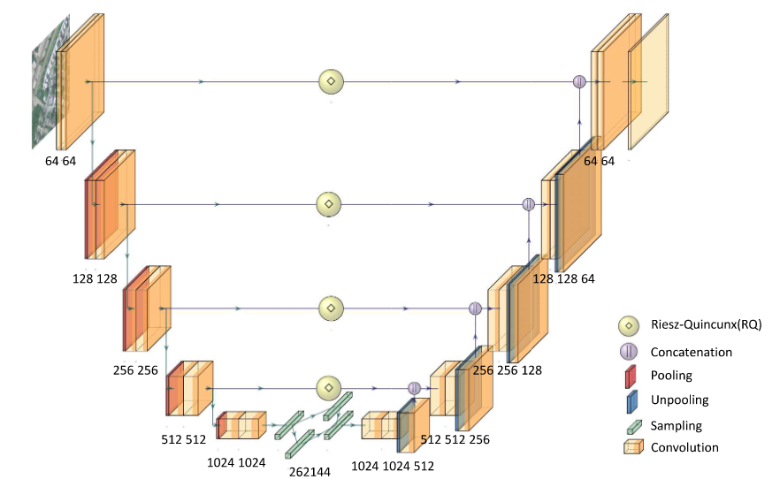
Blurry Output
Rough ideas 2
Traditionally, U-Net can be used to separate levels of locality

Slide 25
Thank you for listening
Presenter: Kim Seung Hwan (overnap@khu.ac.kr)

